Slide 1
Automated Web Fuzzing with Wfuzz
ECE653 Project Presentation
Group member: Xinyi Ma, Shuoyuan Chen, Jiahao Shi
Date: 2020.08.23

Slide 2
Introduction
Cyber security
HTTP

Slide 3

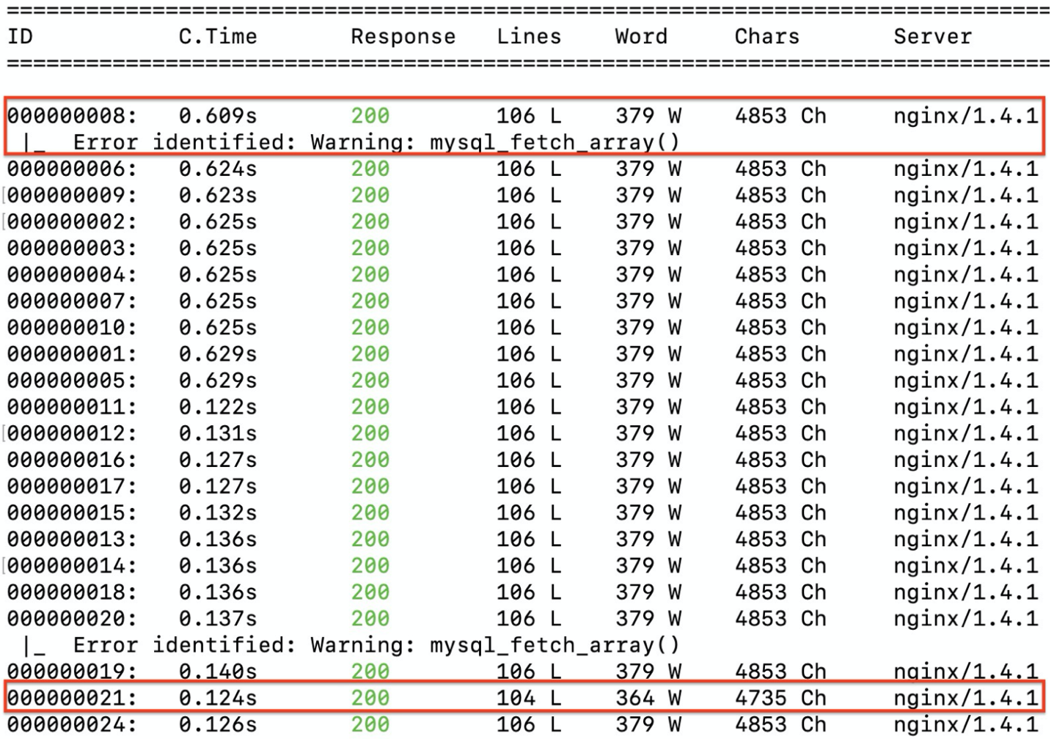
Wfuzz
wfuzz -z file,wordlist/SQL.txt --hc 404 http://testphp.vulnweb.com/listproducts.php?cat=FUZZ
payload
filter
URL
param
Fuzz on URL / POST parameter
Filter output
Plugins: error detection

Slide 4
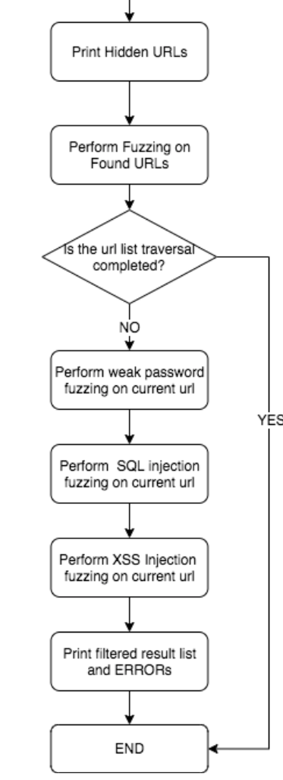
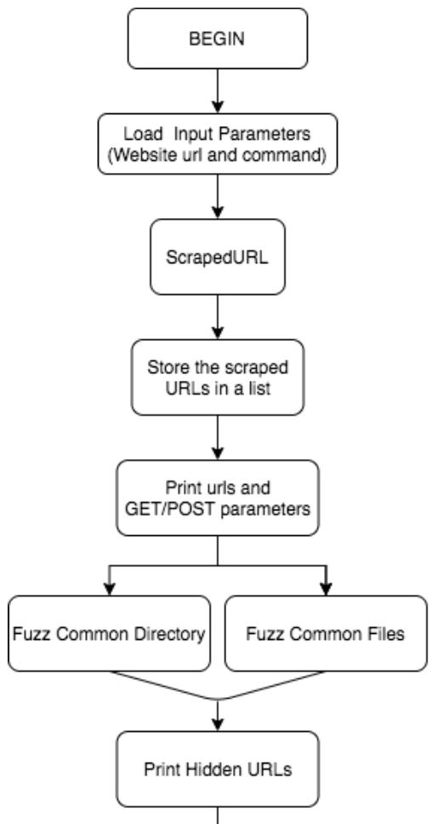
Fuzzing Steps

Slide 5
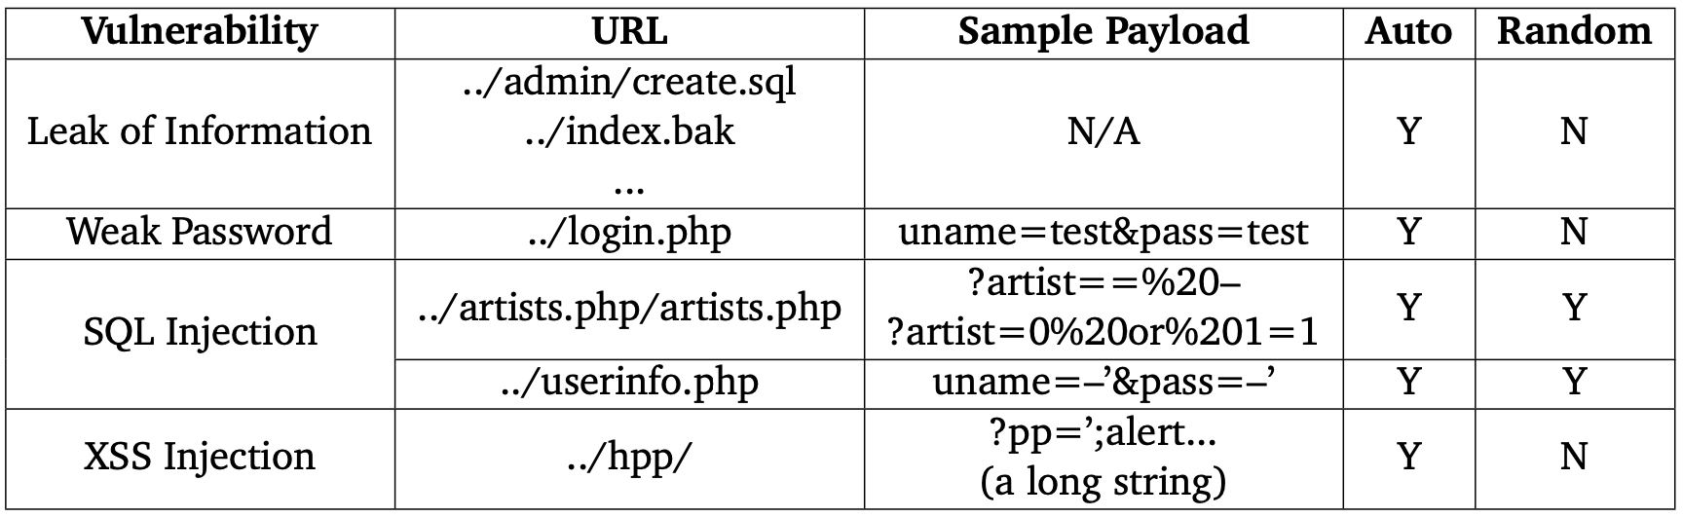
Experimental Results
testphp.vulnweb.com

Slide 6
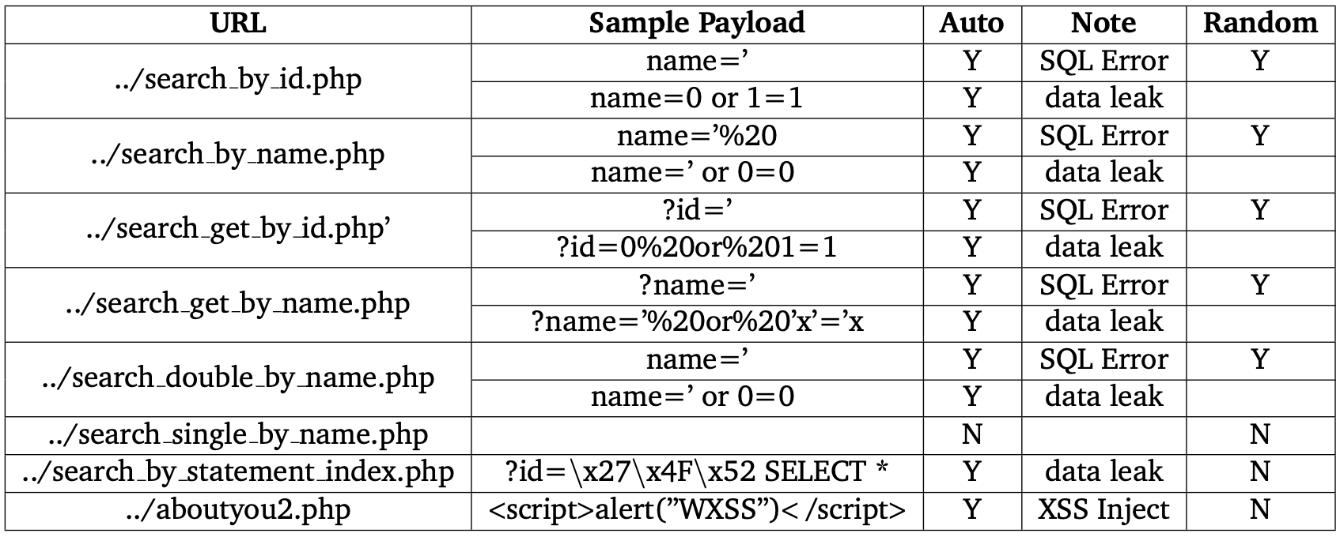
Experimental Results
www.webscantest.com

